Slide 1


ADVANCED GRAPH COLOURING
DM Project

Slide 2


Group Members:
Arjun Tandon (2022095)
Baljyot Singh Modi (2022133)
Debjit Banerji (2022146)

Slide 3
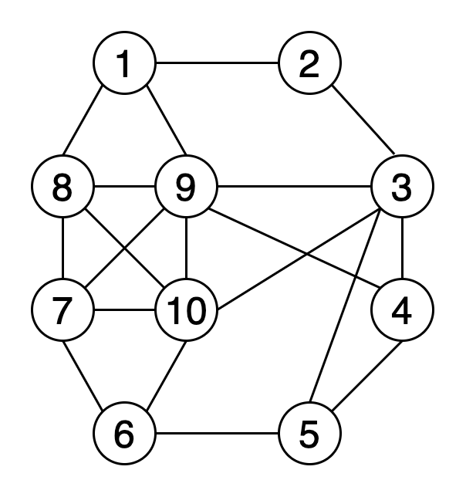
Graph Colouring
One of the most basic and important topics of Graph Colouring
Special Case of Graph Labelling
A way of colouring the vertices of a graph such that no two adjacent vertices are of the same colour

Slide 4
Common Graph Colouring Techniques
Greedy Algorithm
Backtracking Algorithm
Welsh – Powell Algorithm
DSATUR (Degree of Saturation) Algorithm

Slide 5
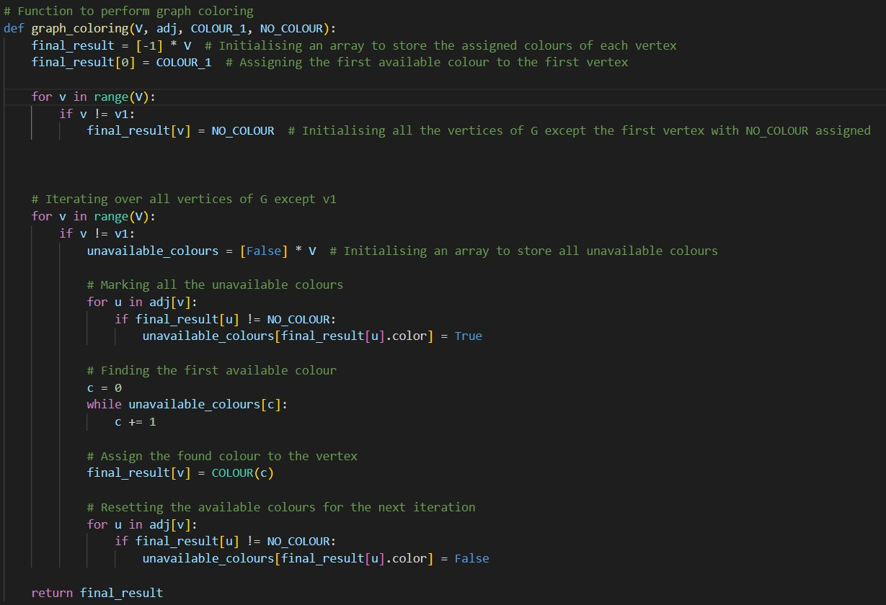
Greedy Algorithm

Slide 6
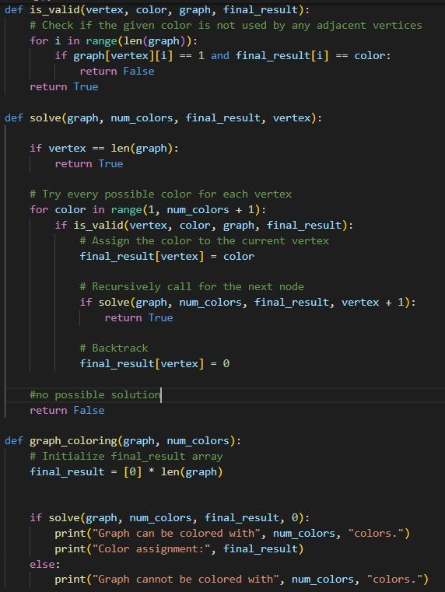
Backtracking Algorithm

Slide 7
Hybrid & Metaheuristic Algorithms
Genetic Algorithm
Tabu Search
Ant Colony Optimization

Slide 8
GENETIC GRAPH COLOURING ALGORITHM

Slide 9
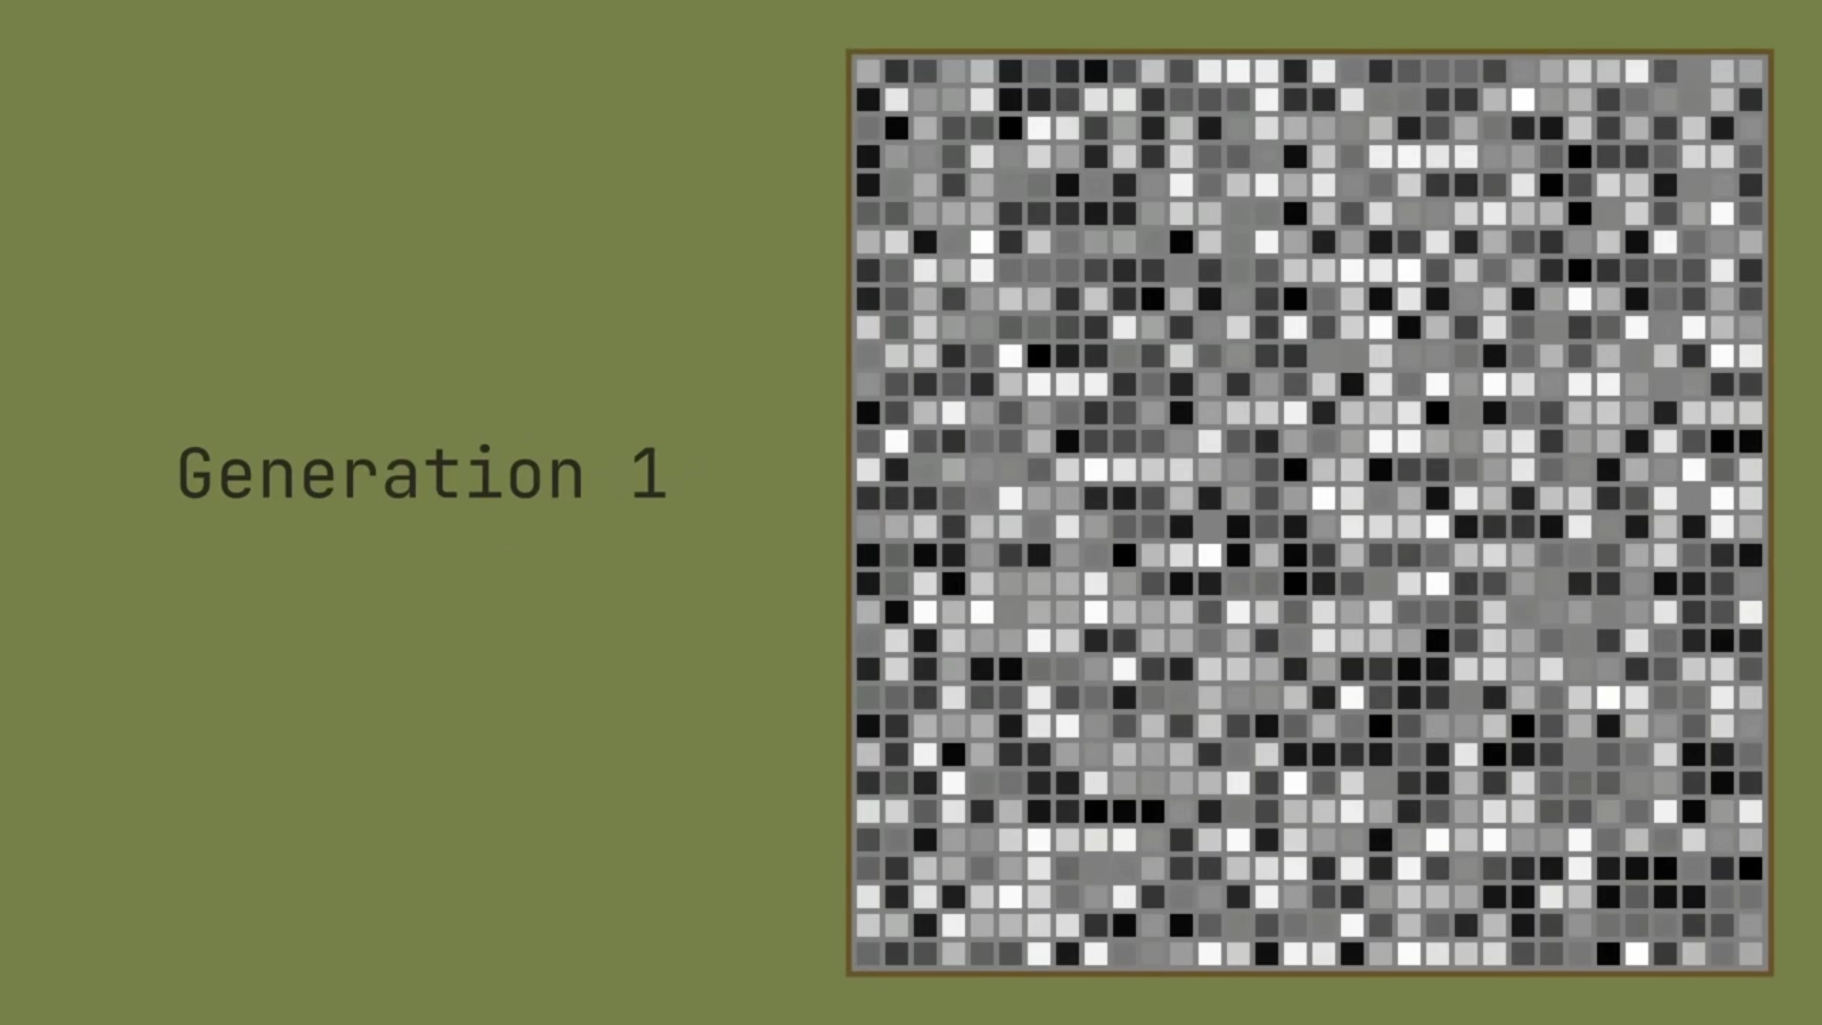
What is Genetic Algorithm?

Slide 10
GeneList
What does it contain?

Slide 11
What does it contain?
GeneList Node #0
GeneList Node #1
GeneList Node #2
GeneList Node #3
GeneList Node #4
GeneList Node #5
GeneList Node #6
GeneList Node #7
GeneList Node #8
GeneList Node #9
GeneList Node #10
GeneList Node #11

Slide 12
GeneList Node
What does it contain?

Slide 13
GeneList Node
CONTENTS : What information does it have?
A possible coloring of the graph
Fitness parameter
But what is the fitness parameter?

Slide 14
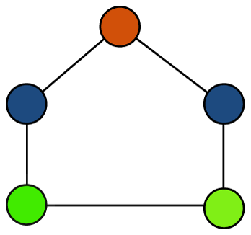
FITNESS PARAMETER
For the fitness parameter, we need the graph coloring stored inside the GeneListNode
It will have a root node too! Let it be the green node

Slide 15
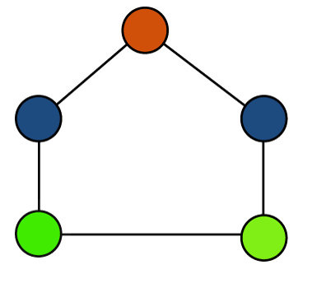
FITNESS PARAMETER = 0
We iterate through each node. Starting from the the green one. It is our current node
Check the neighboring nodes of the current node.
Check if they have the same color as the current node
If yes? Then increase fitness by 1 and move to the next node
#2
#3
#1
#4
#0
GREEN == GREEN!
GREEN ≠ BLUE
Same color found!
Fitness has to be increased by one
And then we move to the next node
+1

Slide 16
FITNESS PARAMETER = 1
We move on to the next node. The blue one (#1) . It is our current node
Check the neighboring nodes of the current node.
Check if they have the same color as the current node
If yes? Then increase fitness by 1 and move to the next node
#2
#3
#1
#4
#0
BLUE ≠ GREEN
BLUE ≠ ORANGE
Different colors =>
No changes to be made to fitness
∴ We move to the next node

Slide 17
FITNESS PARAMETER = 1
We move on to the next node. The orange one (#2) . It is our current node
Check the neighboring nodes of the current node.
Check if they have the same color as the current node
If yes? Then increase fitness by 1 and move to the next node
#2
#3
#1
#4
#0
ORANGE ≠ BLUE
ORANGE ≠ BLUE
Different colors =>
No changes to be made to fitness
∴ We move to the next node

Slide 18
FITNESS PARAMETER = 1
We move on to the next node. The blue one (#3) . It is our current node
Check the neighboring nodes of the current node.
Check if they have the same color as the current node
If yes? Then increase fitness by 1 and move to the next node
#2
#3
#1
#4
#0
BLUE ≠ ORANGE
BLUE ≠ GREEN
Different colors =>
No changes to be made to fitness
∴ We move to the next node

Slide 19
FITNESS PARAMETER = 1
We move on to the next node. The green one (#4) . It is our current node
Check the neighboring nodes of the current node.
Check if they have the same color as the current node
If yes? Then increase fitness by 1 and move to the next node
#2
#3
#1
#4
#0
GREEN ≠ BLUE
GREEN == GREEN
Same color found!
Fitness has to be increased by one
No more nodes to
+1

Slide 20
GeneList Node
CONTENTS :
A graph coloring :
Fitness parameter : 2

Slide 21
GeneList Node
CONTENTS :
A graph coloring :
Fitness parameter : 2

Slide 22
Back to the GeneList and its contents
GeneList Node #0
GeneList Node #1
GeneList Node #2
GeneList Node #3
GeneList Node #4
GeneList Node #5
GeneList Node #6
GeneList Node #7
GeneList Node #8
GeneList Node #9
GeneList Node #10
GeneList Node #11

Slide 23
Calculate Fitness of each node
GeneList Node #0
GeneList Node #1
GeneList Node #2
GeneList Node #3
GeneList Node #4
GeneList Node #5
GeneList Node #6
GeneList Node #7
GeneList Node #8
GeneList Node #9
GeneList Node #10
GeneList Node #11

Slide 24
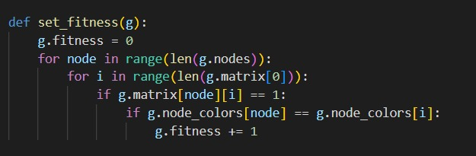
Set Fitness Implementation

Slide 25
Calculate Fitness of each node
GeneList Node #0
GeneList Node #1
GeneList Node #2
GeneList Node #3
GeneList Node #4
GeneList Node #5
GeneList Node #6
GeneList Node #7
GeneList Node #8
GeneList Node #9
GeneList Node #10
GeneList Node #11

Slide 26
Calculate Fitness of each node
GeneList Node #0
Fitness = 2
GeneList Node #1
Fitness = 4
GeneList Node #2
Fitness = 2
GeneList Node #3
Fitness = 8
GeneList Node #0
GeneList Node #1
GeneList Node #2
GeneList Node #3
GeneList Node #4
Fitness = 6
GeneList Node #5
Fitness = 10
GeneList Node #6
Fitness = 12
GeneList Node #7
Fitness = 8
GeneList Node #4
GeneList Node #5
GeneList Node #6
GeneList Node #7
GeneList Node #8
Fitness = 10
GeneList Node #9
Fitness = 14
GeneList Node #10
Fitness = 12
GeneList Node #11
Fitness = 6
GeneList Node #8
GeneList Node #9
GeneList Node #10
GeneList Node #11

Slide 27
Calculate Fitness of each node
GeneList Node #0
Fitness = 2
GeneList Node #1
Fitness = 4
GeneList Node #2
Fitness = 2
GeneList Node #3
Fitness = 8
GeneList Node #4
Fitness = 6
GeneList Node #5
Fitness = 10
GeneList Node #6
Fitness = 12
GeneList Node #7
Fitness = 8
GeneList Node #8
Fitness = 10
GeneList Node #9
Fitness = 14
GeneList Node #10
Fitness = 12
GeneList Node #11
Fitness = 6

Slide 28
Sort on the basis of fitness!
GeneList Node #0
Fitness = 2
GeneList Node #1
Fitness = 4
GeneList Node #2
Fitness = 2
GeneList Node #3
Fitness = 8
GeneList Node #4
Fitness = 6
GeneList Node #5
Fitness = 10
GeneList Node #6
Fitness = 12
GeneList Node #7
Fitness = 8
GeneList Node #8
Fitness = 10
GeneList Node #9
Fitness = 14
GeneList Node #10
Fitness = 12
GeneList Node #11
Fitness = 6

Slide 29
The best node we got here was of FITNESS = 2 (0 is desirable)
GeneList Node #0
Fitness = 2
GeneList Node #1
Fitness = 4
GeneList Node #2
Fitness = 2
GeneList Node #3
Fitness = 8
GeneList Node #4
Fitness = 6
GeneList Node #5
Fitness = 10
GeneList Node #6
Fitness = 12
GeneList Node #7
Fitness = 8
GeneList Node #8
Fitness = 10
GeneList Node #9
Fitness = 14
GeneList Node #10
Fitness = 12
GeneList Node #11
Fitness = 6

Slide 30
Sort on the basis of fitness!
GeneList Node #0
Fitness = 2
GeneList Node #2
Fitness = 2
GeneList Node #1
Fitness = 4
GeneList Node #4
Fitness = 6
GeneList Node #11
Fitness = 6
GeneList Node #3
Fitness = 8
GeneList Node #7
Fitness = 8
GeneList Node #5
Fitness = 10
GeneList Node #8
Fitness = 10
GeneList Node #6
Fitness = 12
GeneList Node #10
Fitness = 12
GeneList Node #9
Fitness = 14

Slide 31

Sort on the basis of fitness!
GeneList Node #0
Fitness = 2
GeneList Node #2
Fitness = 2
GeneList Node #1
Fitness = 4
GeneList Node #4
Fitness = 6
GeneList Node #11
Fitness = 6
GeneList Node #3
Fitness = 8
GeneList Node #7
Fitness = 8
GeneList Node #5
Fitness = 10
GeneList Node #8
Fitness = 10
GeneList Node #6
Fitness = 12
GeneList Node #10
Fitness = 12
GeneList Node #9
Fitness = 14

Slide 32
We will now discard the bottom half of the sorted genelist
GeneList Node #0
Fitness = 2
GeneList Node #2
Fitness = 2
GeneList Node #1
Fitness = 4
GeneList Node #4
Fitness = 6
GeneList Node #11
Fitness = 6
GeneList Node #3
Fitness = 8
GeneList Node #7
Fitness = 8
GeneList Node #5
Fitness = 10
GeneList Node #8
Fitness = 10
GeneList Node #6
Fitness = 12
GeneList Node #10
Fitness = 12
GeneList Node #9
Fitness = 14

Slide 33
GeneList Node #9
Fitness = 14
We will now discard the bottom half of the sorted genelist
GeneList Node #10
Fitness = 12
GeneList Node #0
Fitness = 2
GeneList Node #2
Fitness = 2
GeneList Node #1
Fitness = 4
GeneList Node #4
Fitness = 6
GeneList Node #6
Fitness = 12
GeneList Node #8
Fitness = 10
GeneList Node #5
Fitness = 10
GeneList Node #11
Fitness = 6
GeneList Node #3
Fitness = 8
GeneList Node #7
Fitness = 8

Slide 34
We will now discard the bottom half of the sorted genelist
GeneList Node #0
Fitness = 2
GeneList Node #2
Fitness = 2
GeneList Node #1
Fitness = 4
GeneList Node #4
Fitness = 6
GeneList Node #11
Fitness = 6
GeneList Node #3
Fitness = 8
GeneList Node #9
Fitness = 14
GeneList Node #6
Fitness = 12
GeneList Node #10
Fitness = 12
GeneList Node #8
Fitness = 10
GeneList Node #5
Fitness = 10
GeneList Node #7
Fitness = 8

Slide 35
Time for CROSSOVER!
GeneList Node #0
Fitness = 2
GeneList Node #2
Fitness = 2
GeneList Node #1
Fitness = 4
GeneList Node #4
Fitness = 6
GeneList Node #11
Fitness = 6
GeneList Node #3
Fitness = 8

Slide 36
Pair up the GeneList Nodes!
GeneList Node #0
Fitness = 2
GeneList Node #2
Fitness = 2
GeneList Node #1
Fitness = 4
GeneList Node #4
Fitness = 6
GeneList Node #11
Fitness = 6
GeneList Node #3
Fitness = 8

Slide 37
We have 3 pairs of parents
GeneList Node #0
Fitness = 2
GeneList Node #2
Fitness = 2
GeneList Node #11
Fitness = 6
GeneList Node #3
Fitness = 8
GeneList Node #1
Fitness = 4
GeneList Node #4
Fitness = 6

Slide 38
Each pair will give two children!
Childrens are created using CROSSOVER ALGORITHM
Child 1 of
GeneList Node #0 and #2
Child 2 of
GeneList Node #0 and #2
Child 2 of
GeneList Node #0 and #2
Child 1 of
GeneList Node #1 and #4
Child 2 of
GeneList Node #1 and #4
GeneList Node #2
Fitness = 2
GeneList Node #11
Fitness = 6
GeneList Node #0
Fitness = 2
Child 1 of
GeneList Node #11 and #3
GeneList Node #3
Fitness = 8
GeneList Node #1
Fitness = 4
GeneList Node #4
Fitness = 6

Slide 39
GENELIST BEFORE CROSSOVER!
GeneList Node #0
Fitness = 2
GeneList Node #2
Fitness = 2
GeneList Node #1
Fitness = 4
GeneList Node #4
Fitness = 6
GeneList Node #11
Fitness = 6
GeneList Node #3
Fitness = 8

Slide 40
GENELIST AFTER CROSSOVER!
GeneList Node #0
Fitness = 2
GeneList Node #2
Fitness = 2
GeneList Node #1
Fitness = 4
GeneList Node #4
Fitness = 6
GeneList Node #11
Fitness = 6
GeneList Node #3
Fitness = 8
Child 1 of
GeneList Node #0 and #2
Child 2 of
GeneList Node #0 and #2
Child 1 of
GeneList Node #11 and #3
Child 2 of
GeneList Node #0 and #2
Child 1 of
GeneList Node #1 and #4
Child 2 of
GeneList Node #1 and #4

Slide 41
CROSSOVER THROUGH AN EXAMPLE!
NODE 1
NODE 2
Fitness = 2
Fitness = 2

Slide 42
RANDOMLY GENERATE A PIVOT!
NODE 1
NODE 2
Fitness = 2
Fitness = 2

Slide 43
Let’s say pivot is 2nd index!
#2
#2
#0
#0
NODE 1
NODE 2
Fitness = 2
Fitness = 2

Slide 44
Let’s say pivot is 2nd index!
#2
#2
#0
#0
NODE 1
NODE 2
Fitness = 2
Fitness = 2

Slide 45
Let’s say pivot is 2nd index!
#2
#2
#2
#2
#0
#0
#0
#0
NODE 1
NODE 2
Fitness = 2
Fitness = 2

Slide 46
Let’s say pivot is 2nd index!
#2
#2
#2
#2
INTERCHANGE!
#0
#0
#0
#0
NODE 1
NODE 2
Fitness = 2
Fitness = 2

Slide 47
#2
#2
#0
#0
CHILD 1
CHILD 2
Fitness = 2
Fitness = 0

Slide 48
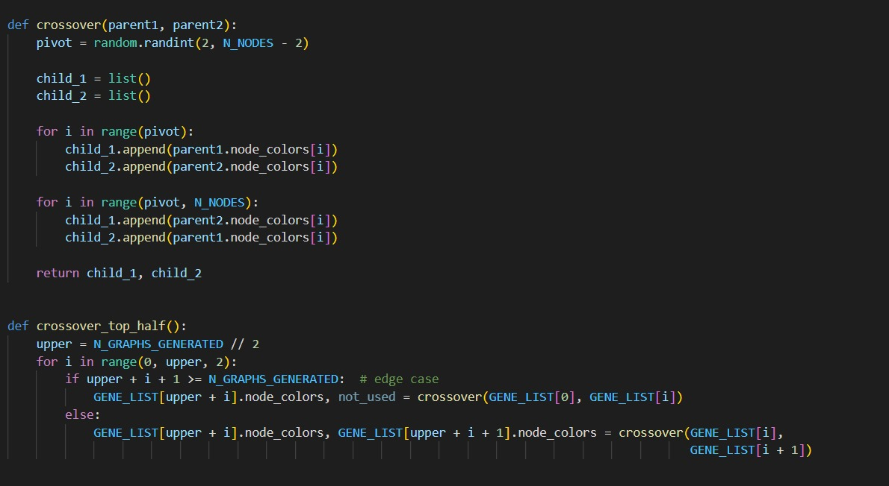
Cross-Over Implementation

Slide 49
GENELIST AFTER CROSSOVER!
GeneList Node #0
Fitness = 2
GeneList Node #2
Fitness = 2
GeneList Node #1
Fitness = 4
GeneList Node #4
Fitness = 6
GeneList Node #11
Fitness = 6
GeneList Node #3
Fitness = 8
Child 1 of
GeneList Node #0 and #2
Child 2 of
GeneList Node #0 and #2
Child 1 of
GeneList Node #11 and #3
Child 2 of
GeneList Node #0 and #2
Child 1 of
GeneList Node #1 and #4
Child 2 of
GeneList Node #1 and #4

Slide 50
WHAT AFTER CROSSOVER?
GeneList Node #0
Fitness = 2
GeneList Node #2
Fitness = 2
GeneList Node #1
Fitness = 4
GeneList Node #4
Fitness = 6
GeneList Node #11
Fitness = 6
GeneList Node #3
Fitness = 8
Child 1 of
GeneList Node #0 and #2
Child 2 of
GeneList Node #0 and #2
Child 1 of
GeneList Node #11 and #3
Child 2 of
GeneList Node #0 and #2
Child 1 of
GeneList Node #1 and #4
Child 2 of
GeneList Node #1 and #4

Slide 51
WE MUTATE THE CHILDREN!
GeneList Node #0
Fitness = 2
GeneList Node #2
Fitness = 2
GeneList Node #1
Fitness = 4
GeneList Node #4
Fitness = 6
GeneList Node #11
Fitness = 6
GeneList Node #3
Fitness = 8
Child 1 of
GeneList Node #0 and #2
Child 2 of
GeneList Node #0 and #2
Child 1 of
GeneList Node #11 and #3
Child 2 of
GeneList Node #0 and #2
Child 1 of
GeneList Node #1 and #4
Child 2 of
GeneList Node #1 and #4

Slide 52
BUT WHAT IS MUTATION?
GeneList Node #0
Fitness = 2
GeneList Node #2
Fitness = 2
GeneList Node #1
Fitness = 4
GeneList Node #4
Fitness = 6
GeneList Node #11
Fitness = 6
GeneList Node #3
Fitness = 8
Child 1 of
GeneList Node #0 and #2
Child 2 of
GeneList Node #0 and #2
Child 1 of
GeneList Node #11 and #3
Child 2 of
GeneList Node #0 and #2
Child 1 of
GeneList Node #1 and #4
Child 2 of
GeneList Node #1 and #4

Slide 53
MUTATION
MUTATION CONSTANT = 0.2
Set a Mutation Constant between 0 and 1
Let’s say it is 0.2
NODE 1
Fitness = 2

Slide 54
MUTATION
MUTATION CONSTANT = 0.2
Iterate on each node
Generate a random number between 0 & 1
i = 0

Slide 55

MUTATION
MUTATION CONSTANT = 0.2
Generate a random number between 0 & 1
Number generated = 0.17
i = 0

Slide 56
MUTATION
MUTATION CONSTANT = 0.2
Generate a random number between 0 & 1
Number generated = 0.17
i = 0
Number generated
< 0.2 !

Slide 57
MUTATION
MUTATION CONSTANT = 0.2
We generated a random number 0.17
Number generated
< 0.2 ! So choose a random color among the available ones
i = 0

Slide 58
MUTATION
MUTATION CONSTANT = 0.2
Random color chosen
i = 0

Slide 59
MUTATION
MUTATION CONSTANT = 0.2
Random color chosen
Swap the current (i = 0) node’s color color with this color!
i = 0

Slide 60
MUTATION
MUTATION CONSTANT = 0.2
Random color chosen
Swap the current (i = 0) node’s color color with this color!
i = 0

Slide 61
MUTATION
MUTATION CONSTANT = 0.2
We move to the next node
i = 0

Slide 62
MUTATION
MUTATION CONSTANT = 0.2
Generate a random number between 0 & 1
i = 1
Number generated = 0.44

Slide 63
MUTATION
MUTATION CONSTANT = 0.2
Generate a random number between 0 & 1
i = 1
Number generated = 0.17
Number generated is > 0.2 !

Slide 64
MUTATION
MUTATION CONSTANT = 0.2
We generated a random number 0.44
i = 1
Number generated is > 0.2 so we just move on, to the next node

Slide 65
MUTATION
MUTATION CONSTANT = 0.2
We move to the next node
i = 1

Slide 66
MUTATION
MUTATION CONSTANT = 0.2
Generate a random number between 0 & 1
i = 2
Number generated = 0.85

Slide 67
MUTATION
MUTATION CONSTANT = 0.2
Generate a random number between 0 & 1
i = 2
Number generated = 0.85
Number generated is > 0.2 !

Slide 68
MUTATION
MUTATION CONSTANT = 0.2
We generated a random number 0.85
i = 2
Number generated is > 0.2 so we just move on, to the next node

Slide 69
MUTATION
MUTATION CONSTANT = 0.2
We move to the next node
i = 2

Slide 70
MUTATION
MUTATION CONSTANT = 0.2
Generate a random number between 0 & 1
i = 3
Number generated = 0.12

Slide 71
MUTATION
MUTATION CONSTANT = 0.2
Generate a random number between 0 & 1
i = 3
Number generated = 0.12
Number generated
< 0.2 !

Slide 72
MUTATION
MUTATION CONSTANT = 0.2
We generated a random number 0.12
i = 3
Number generated
< 0.2 ! So choose a random color among the available ones

Slide 73
MUTATION
MUTATION CONSTANT = 0.2
Random color chosen
i = 3

Slide 74
MUTATION
MUTATION CONSTANT = 0.2
Random color chosen
i = 3
Swap the current (i = 0) node’s color color with this color!

Slide 75
MUTATION
MUTATION CONSTANT = 0.2
Random color chosen
i = 3
Swap the current (i = 0) node’s color color with this color!

Slide 76
MUTATION
MUTATION CONSTANT = 0.2
We move to the next node
i = 3

Slide 77
MUTATION
MUTATION CONSTANT = 0.2
Generate a random number between 0 & 1
Number generated = 0.12
i = 4

Slide 78
MUTATION
MUTATION CONSTANT = 0.2
Generate a random number between 0 & 1
Number generated = 0.12
i = 4
Number generated
< 0.2 !

Slide 79
MUTATION
MUTATION CONSTANT = 0.2
We generated a random number 0.12
Number generated
< 0.2 ! So choose a random color among the available ones
i = 4

Slide 80
MUTATION
MUTATION CONSTANT = 0.2
Random color chosen
i = 4

Slide 81
MUTATION
MUTATION CONSTANT = 0.2
Random color chosen
Swap the current (i = 0) node’s color color with this color!
i = 4

Slide 82
MUTATION
MUTATION CONSTANT = 0.2
Random color chosen
Swap the current (i = 0) node’s color color with this color!
i = 4

Slide 83
MUTATION
MUTATION CONSTANT = 0.2
i = 4

Slide 84
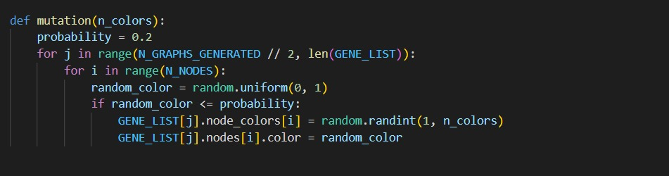
Mutation Implementation

Slide 85
MUTATION
Child 1 of
GeneList Node #0 and #2
Child 1 of
GeneList Node #11 and #3
Child 1 of
GeneList Node #1 and #4
Child 2 of
GeneList Node #0 and #2
Child 2 of
GeneList Node #1 and #4
Child 2 of
GeneList Node #0 and #2

Slide 86
MUTATION
Child 1 of
GeneList Node #0 and #2
Child 1 of
GeneList Node #11 and #3
Child 1 of
GeneList Node #1 and #4
Child 2 of
GeneList Node #0 and #2
Child 2 of
GeneList Node #1 and #4
Child 2 of
GeneList Node #0 and #2
Mutation Algorithm

Slide 87
MUTATION
Mutation Algorithm
Child 1 of
GeneList Node #0 and #2
Child 1 of
GeneList Node #11 and #3
Child 1 of
GeneList Node #1 and #4
Child 2 of
GeneList Node #0 and #2
Child 2 of
GeneList Node #1 and #4
Child 2 of
GeneList Node #0 and #2

Slide 88
MUTATION
Mutation Algorithm
Child 1 of
GeneList Node #0 and #2
Child 1 of
GeneList Node #11 and #3
Child 1 of
GeneList Node #1 and #4
Child 2 of
GeneList Node #0 and #2
Child 2 of
GeneList Node #1 and #4
Child 2 of
GeneList Node #0 and #2

Slide 89
MUTATION
Mutation Algorithm
MUTATED Child 1 of
GeneList Node #0 and #2
MUTATED
Child 1 of
GeneList Node #11 and #3
MUTATED Child 1 of
GeneList Node #1 and #4
MUTATED Child 2 of
GeneList Node #0 and #2
MUTATED Child 2 of
GeneList Node #1 and #4
MUTATED Child 2 of
GeneList Node #0 and #2

Slide 90
MUTATION
Mutation Algorithm
MUTATED Child 1 of
GeneList Node #0 and #2
MUTATED
Child 1 of
GeneList Node #11 and #3
MUTATED Child 1 of
GeneList Node #1 and #4
MUTATED Child 2 of
GeneList Node #0 and #2
MUTATED Child 2 of
GeneList Node #1 and #4
MUTATED Child 2 of
GeneList Node #0 and #2

Slide 91
GENELIST AFTER MUTATION!
GeneList Node #0
Fitness = 2
GeneList Node #2
Fitness = 2
GeneList Node #1
Fitness = 4
GeneList Node #4
Fitness = 6
GeneList Node #11
Fitness = 6
GeneList Node #3
Fitness = 8
MUTATED Child 1 of
GeneList Node #0 and #2
MUTATED Child 2 of
GeneList Node #0 and #2
MUTATED Child 1 of
GeneList Node #11 and #3
MUTATED Child 2 of
GeneList Node #0 and #2
MUTATED Child 1 of
GeneList Node #1 and #4
MUTATED Child 2 of
GeneList Node #1 and #4

Slide 92
IN A NUTSHELL!
We take a graph as input from the user
We have to generate a graph coloring for this graph with the minimum number of colors (chromatic number)
The chromatic number χ(G) of a graph GG is the minimal number of colors for which such an assignment is possible.

Slide 93
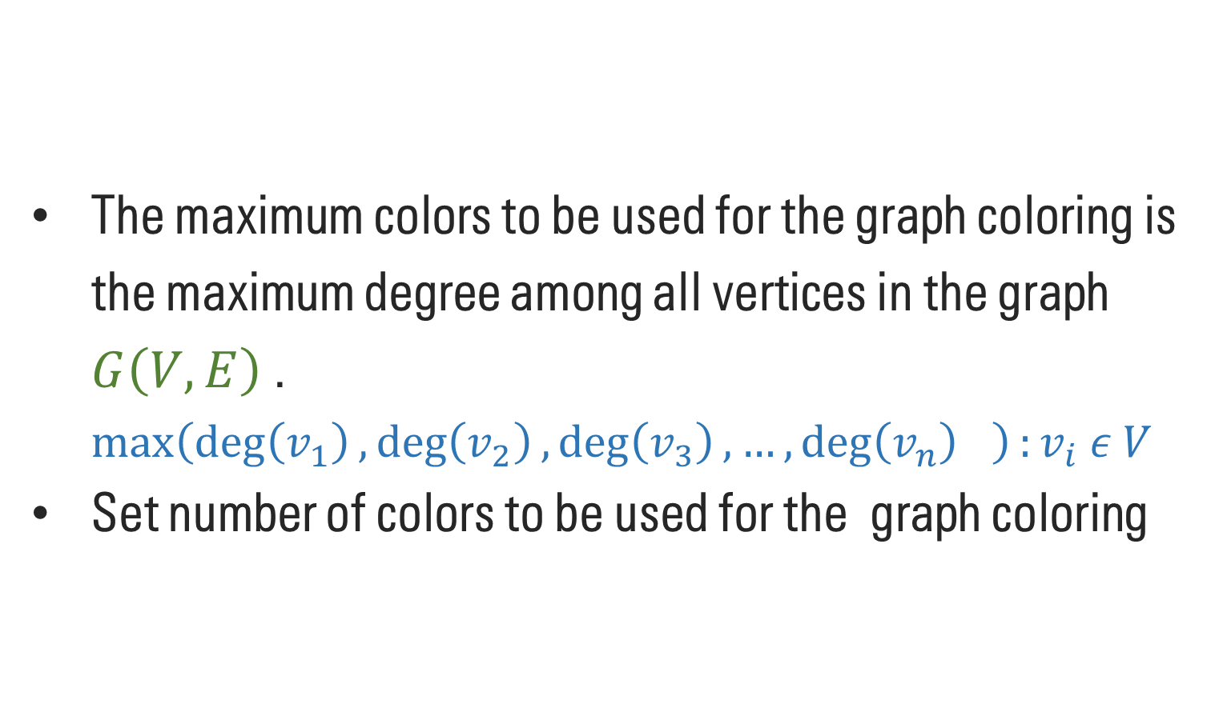
IN A NUTSHELL!
The maximum colors to be used for the graph coloring is the maximum degree among all vertices in the graph $G\left(V,E\right)$ . $\max\left(\deg\left(v_{1}\right),\deg\left(v_{2}\right),\deg\left(v_{3}\right), …,{\deg\left(v_{n}\right)}_{}\right):v_{i} ε V$
Set number of colors to be used for the graph coloring

Slide 94
IN A NUTSHELL!
Randomly populate the GeneList with GeneListNodes (where GeneListNode represents a possible coloring of the input graph) of the previously set number of colors
Now for this fixed number of colors repeat the following (until a node with 0 fitness found or number of generations exceed a large limit like 10,000)

Slide 95
IN A NUTSHELL!
Now for this fixed number of colors repeat the following (until a node with 0 fitness found or number of generations exceed a large limit like 10,000)
1. Calculate fitness
2. Sort on basis of fitness
3. Crossover the first half and reject the others
4. Mutate the newly born children
5. The 5 mutated children and the original 5 parents make the population of the next iteration.

Slide 96
IN A NUTSHELL!
What if you find a GeneList node of fitness 0 in an iteration?
Congrats, the graph is colorable by the number of colors you set in the code.
We then decrease number of colors by 1 and repeat the process until a point reaches where the number of colors are insufficient to solve the coloring.
In that case the generations will keep on occurring and we’ll manually have to check if they exceed a large number implying that probability of any further solution is negligible.

Slide 97
RESULTS

Slide 98
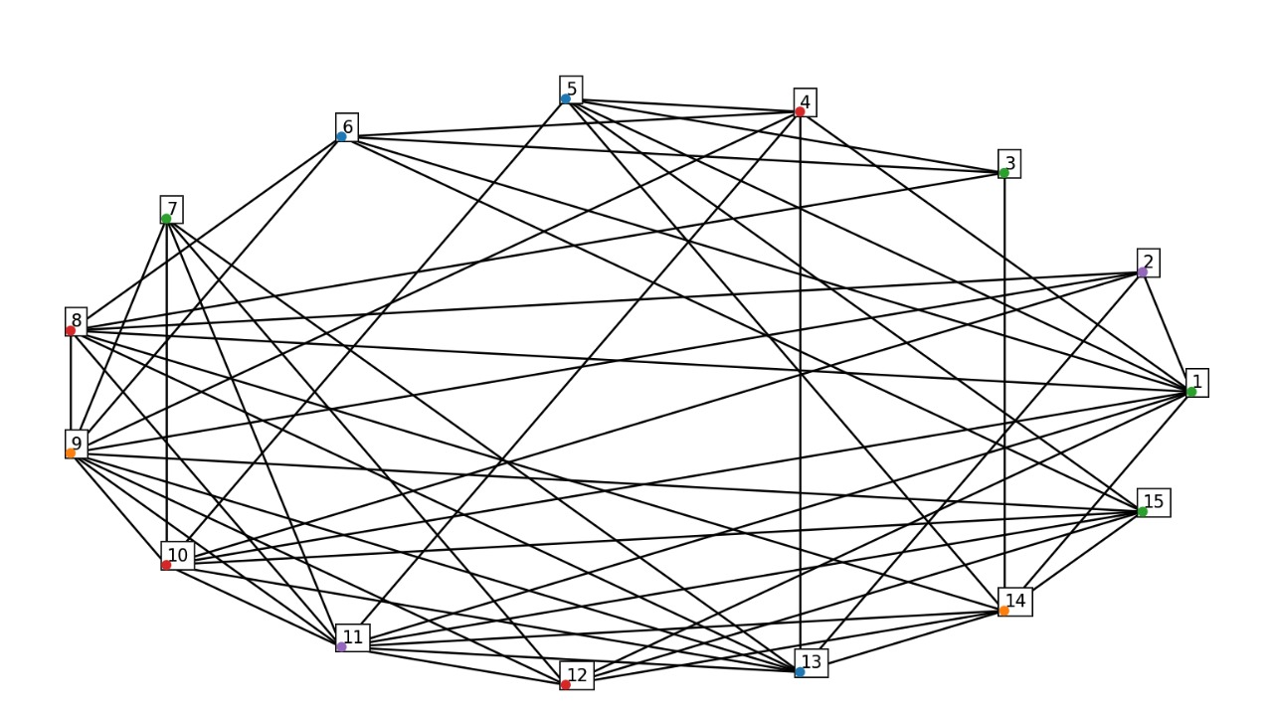
15 Nodes
5 Colourable Graph

Slide 99
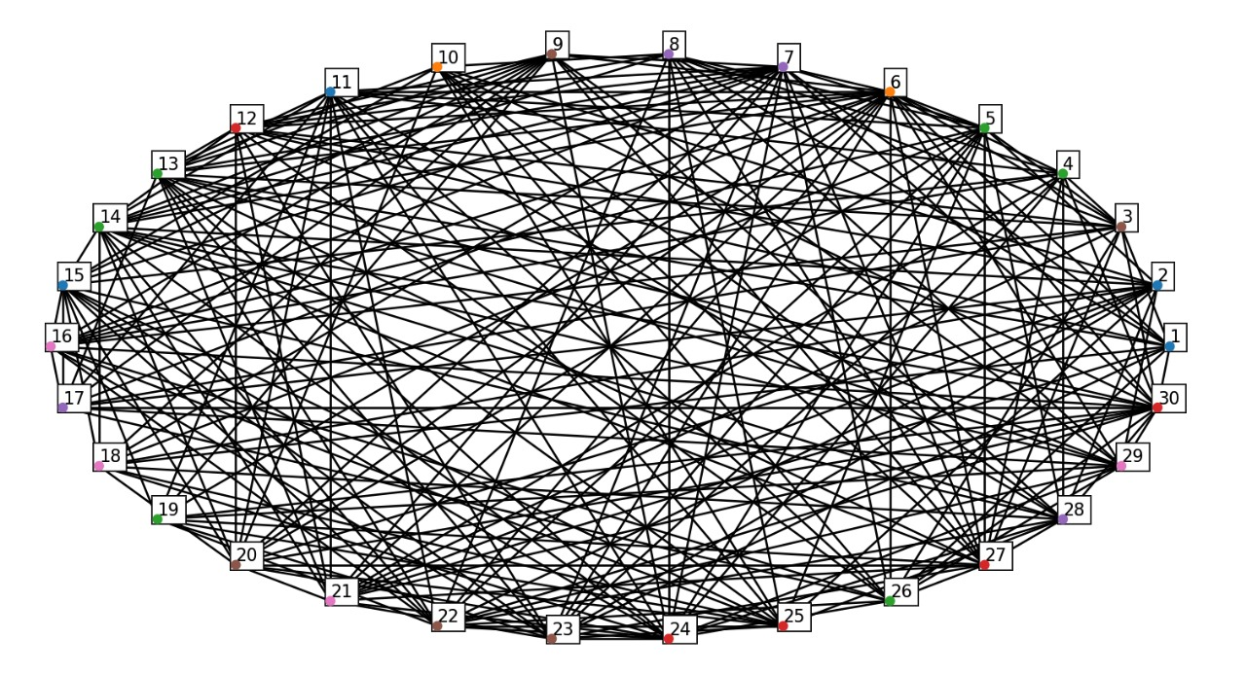
30 Nodes
7 Colourable Graph

Slide 100
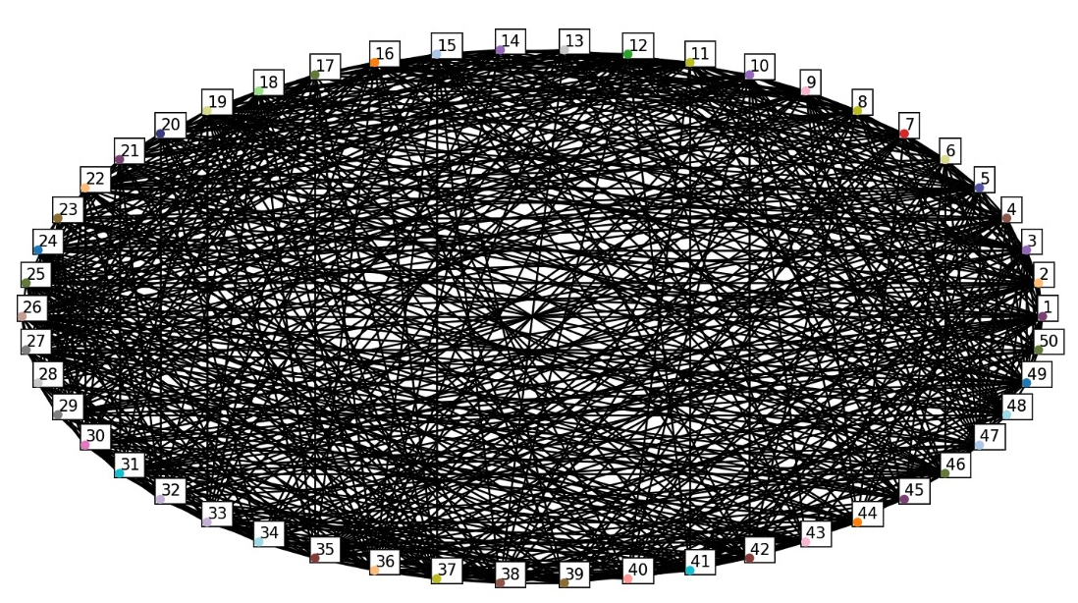
50 Nodes
30 Colourable Graph

Slide 101
REFERENCES
https://en.wikipedia.org/wiki/Genetic_algorithm
https://en.wikipedia.org/wiki/Graph_coloring
https://www.geeksforgeeks.org/project-idea-genetic-algorithms-for-graph-colouring/
https://www.youtube.com/watch?v=XP2sFzp2Rig&t=201s
https://matplotlib.org
https://www.sciencedirect.com/science/article/pii/S1877050918313024
GitHub Repo Link: https://github.com/baljyot25/DM_project

Slide 102
THANK YOU!

